Slide 1
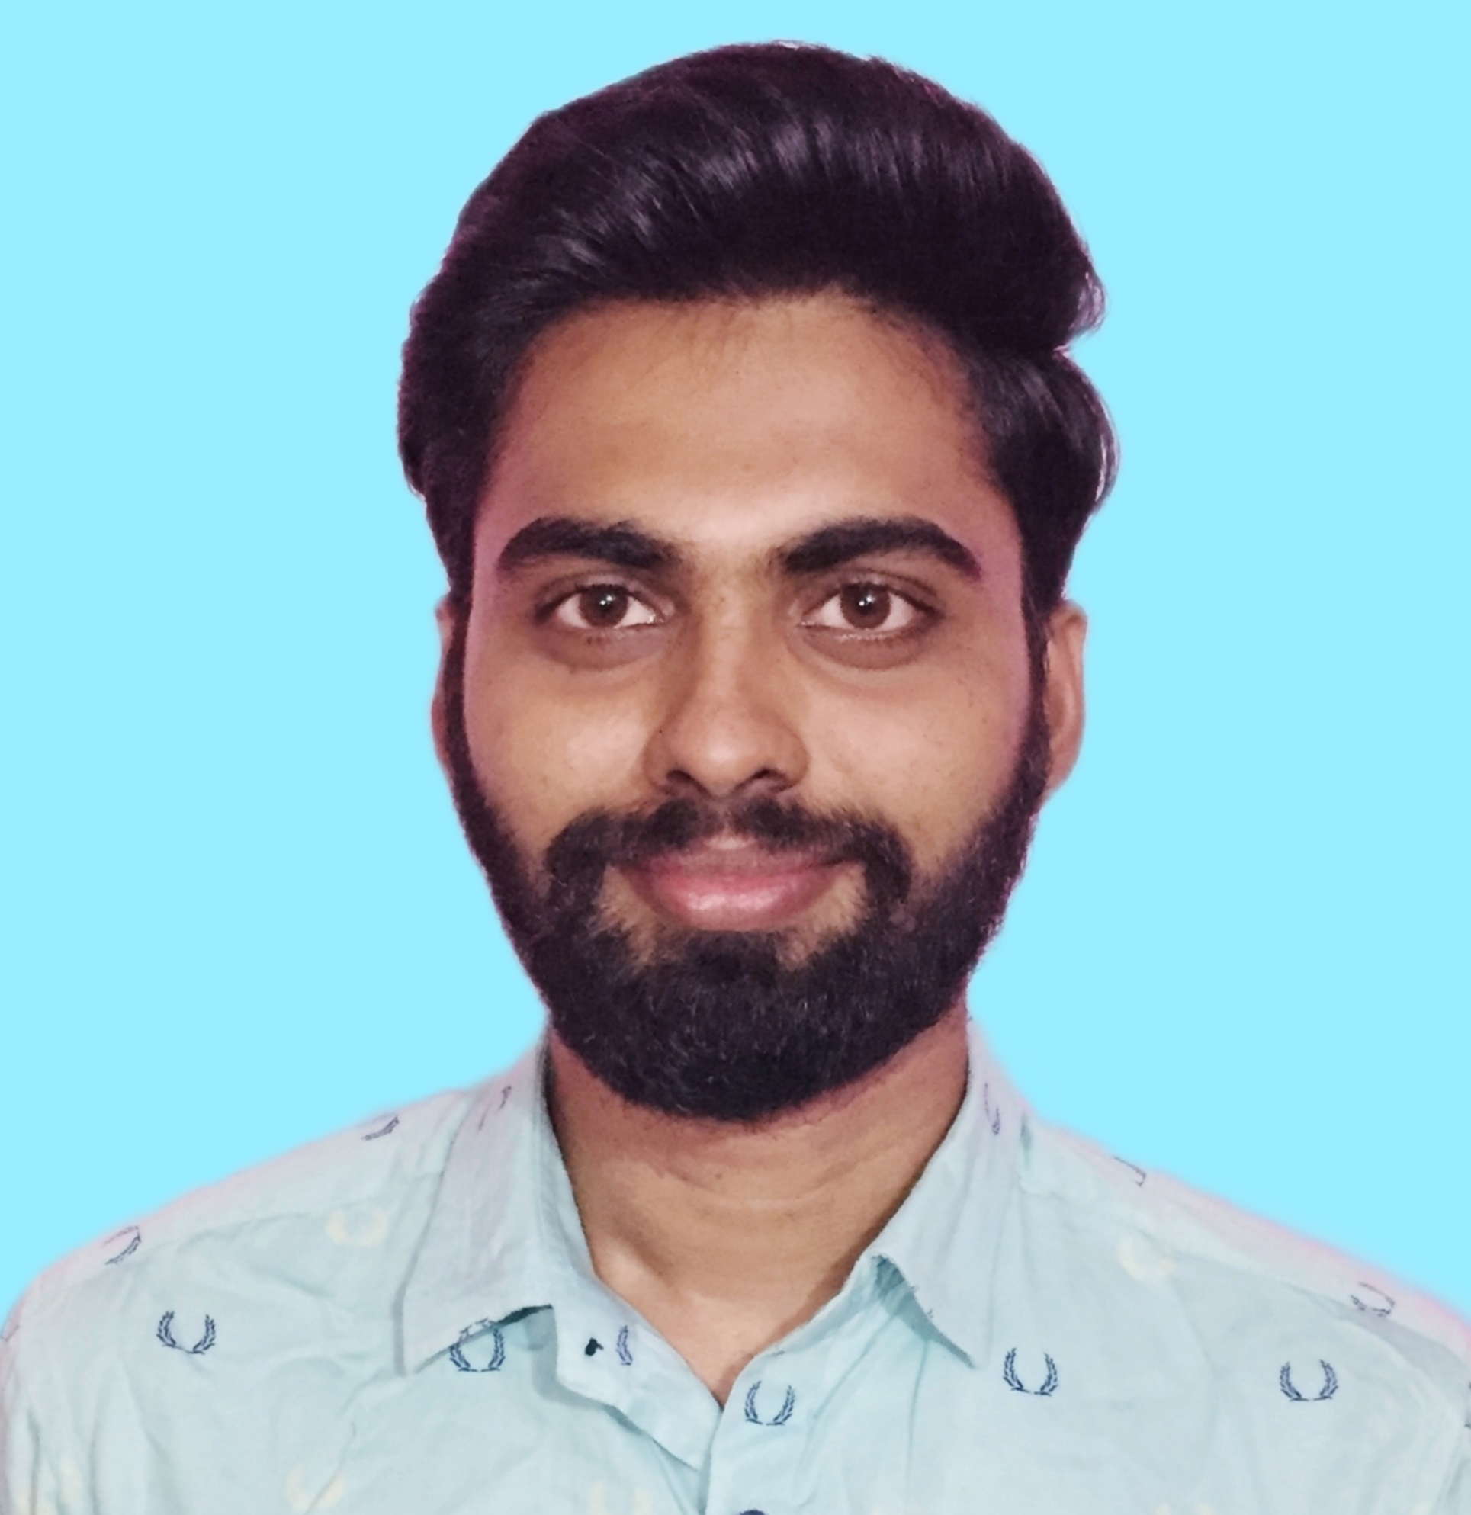



Surya Satya Sai Manikanta Rekhapalli
Bachelor of Technology
Electronics & Communication : 2018 - 2022
Analyst/Software Engineer
Skills
Java 8 /J2EE | Java Basics, OOPS, Generics, Collections, Arrays, Loops, Lambda Exp, Stream API Junit
Spring core | Dependency Injection
Spring REST | REST controllers, Implementation of GET, POST, PUT & DELETE, Bean Validation & Exception Handling, Testing Services, Controller & Repository layer
Spring Data JPA | Implement DAO layer using spring Data repositories, Transaction Management
Spring Boot Microservices | Spring Boot Starters, annotations, Messaging Service, Sync/Async comms, Swagger API documents
Spring Cloud | Eureka,, Netflix Hystrix, Netflix Zuul & Config Server
React | Components, Hooks, Event handling, Redux, Reducers, Testing
Database | MongoDB No Sql Basics Postgre SQL Basics
UI Tech | HTML 5 & CSS 3,JavaScript Reusable templates, Optimized UI Designed
Tools | Git, Postman, Maven, IDE
Add On skills | Communications, Team management. Peer learning
Bangalore
xxxxxxxxxxx@capgemini.com
+91 8374656752
A4
Full Stack Developer
Hands on experience in creating microservices with Springboot, Spring Security, Spring Cloud API Gateway, Eureka server, load balancing
Intermediate in creating Single page Web Application in React with Authentication with route guards, react reactive forms, routing, HTML, CSS
Hands on experience in implementing polyglot architecture with NodeJs & spring boot
Experience in creating documentation with Java docs and swagger and in unit testing using Junit, Mockit
Online Hotel Management System
Completed end to end case study of Hotel Management application along with JWT authentication, Swagger and Payment testing, responsive UI with HTML, CSS and React js used for user interface.
Movie Booking System
Completed end to end case study of Moving Booking Application along with testing, responsive UI with HTML ,CSS and React js used for user interface.
Check out my work on GitHub & Video Profile

